Slide 1
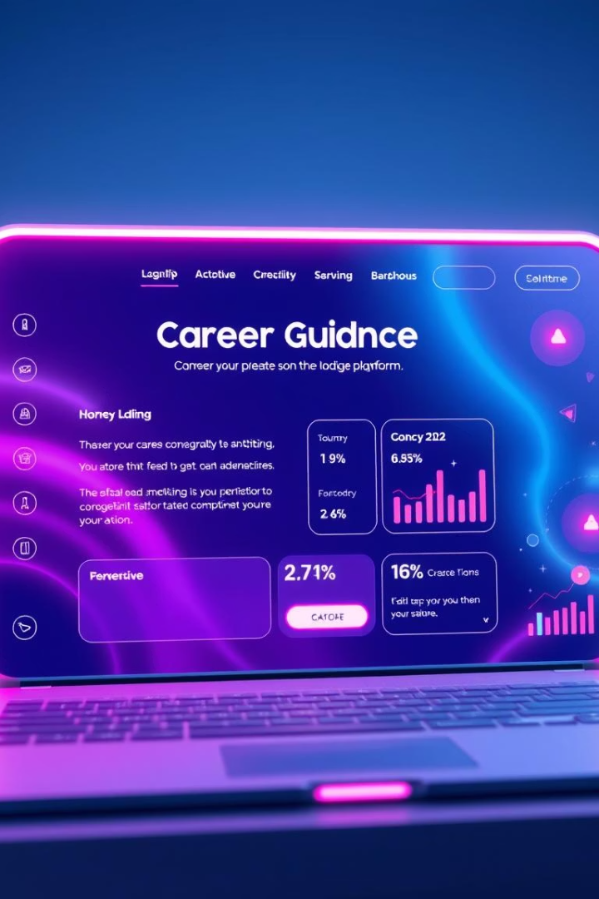
Transforming Career Navigation with AI
Navigating your career path can be complex. Our AI-driven platform simplifies the process. We enhance your decision-making with data on market trends and opportunities. Let's explore how to optimize your career.

Slide 2
The Problem: Modern Career Challenges
Rapidly Evolving Job Market
Skills Mismatches
Lack of Personalized Direction
The job market changes quickly. New roles and skills emerge constantly.
Many professionals lack the right skills. This can hinder their career progression.
It’s hard to know the best path. Insights and guidance are often missing.
Modern career challenges require innovative solutions.

Slide 3
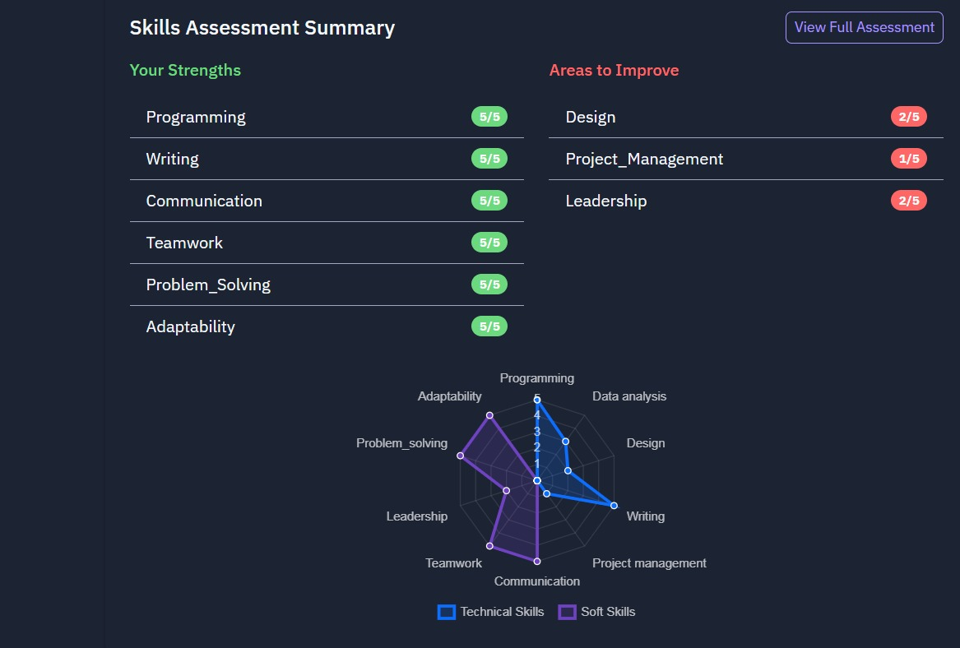



Our Solution: The
AI-Driven Career Platform
Data-Driven Advice
We provide personalized advice using data analysis.
Skills Matching
We match user skills with current market demands.
Comprehensive Coverage
We cover resume optimization, interview prep, and
networking.

Slide 4
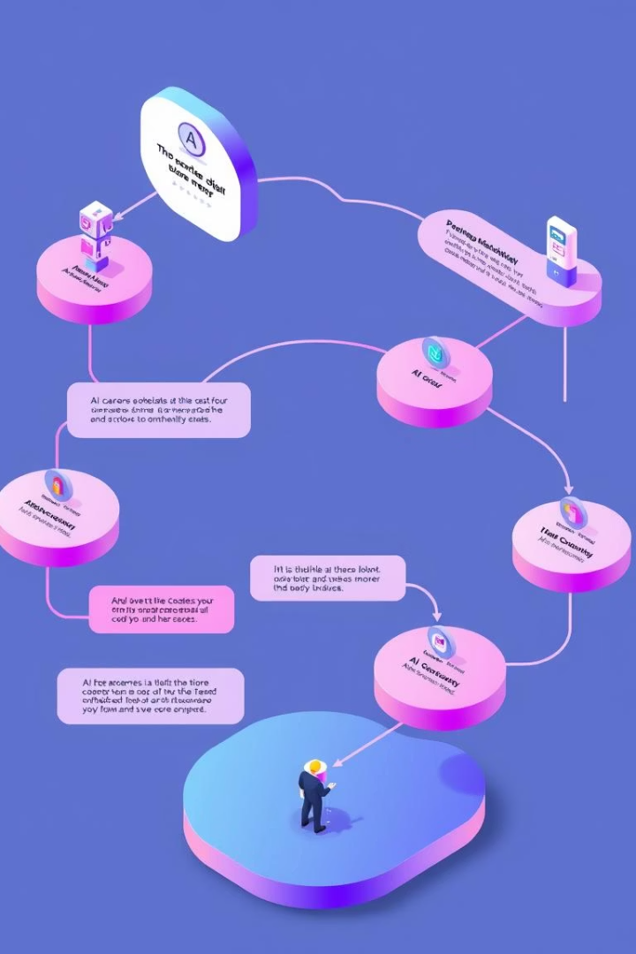



How It Works: A Step-by-Step Process
Assess
Analyze user skills, preferences, and goals.
Match
Compare with real-time job market trends.
Recommend
Deliver tailored career strategies and tips.

Slide 5
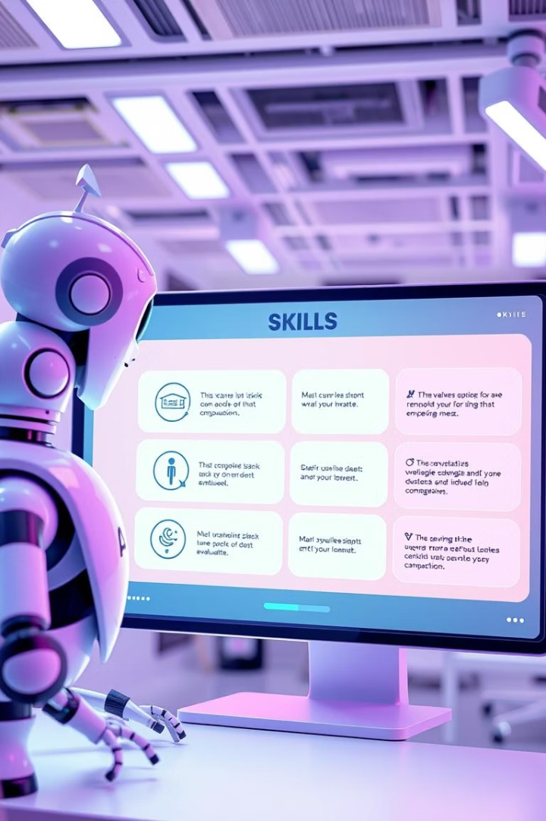
Feature Highlight 1: Skill Assessment
Comprehensive Evaluation
Real-Time Identification
Identifies high-demand skills in real-time.
AI evaluates 100+ skills for relevance.
Industry Benchmarking
Benchmarking against industry norms.

Slide 6

Feature Highlight 2: Personalized Recommendations
Resume Optimization
Networking Strategies
Based on job-specific keywords.
AI-powered outreach tips.
1
2
3
Interview Prep
Custom question prompts and preparation.

Slide 7



Feature Highlight 3: Market Insights and Trends
Predictive Analytics
1
Emerging jobs and skills.
Demand Reports
2
Regional and industry-specific.
Real-Time Updates
3
Proactive career decisions.

Slide 8



User Journey: Real-Life Scenarios
Preparing for Senior Roles
2
1
Transitioning to Tech
Reducing Job Search Time
75% reduced job search time for users.
3

Slide 9

Why This Platform Stands Out
95%
1
∞
Proven Accuracy
Simplifies Decisions
Continuous Updates
Recommendation-match success rate.
In a dynamic market.
Cutting-edge relevance.

Slide 10
Screenshots

Slide 11
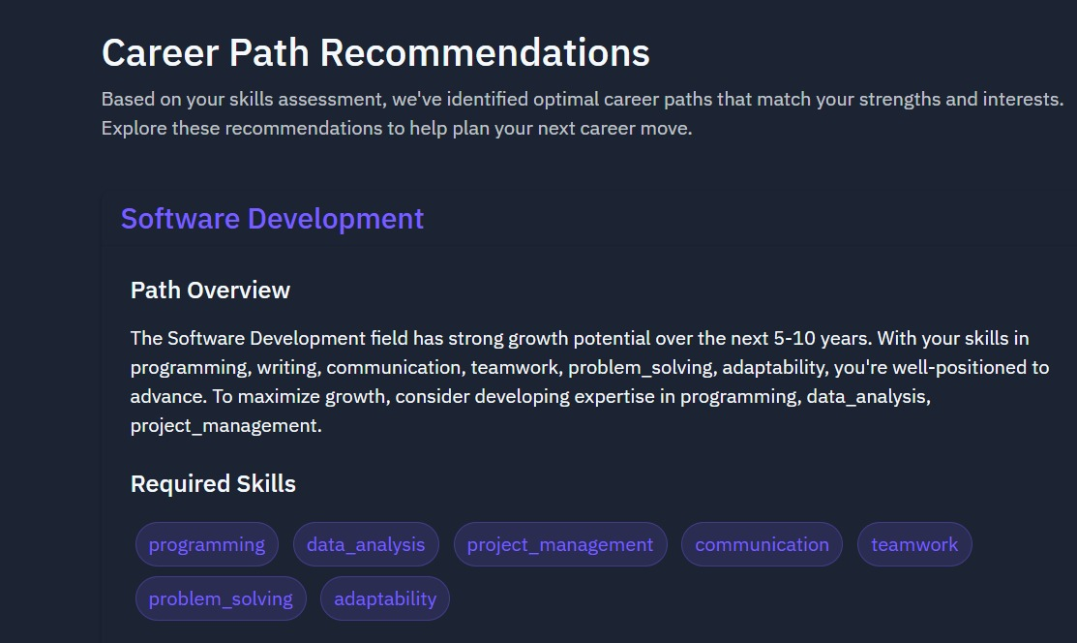
Career Path Recommendation

Slide 12
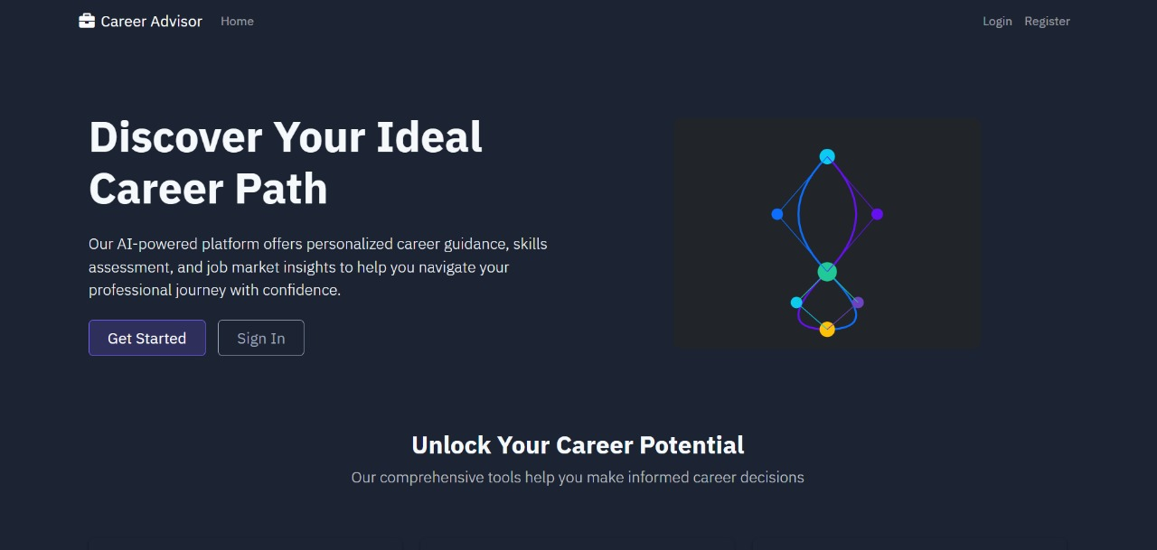
Personalized Career Path Recommendations

Slide 13
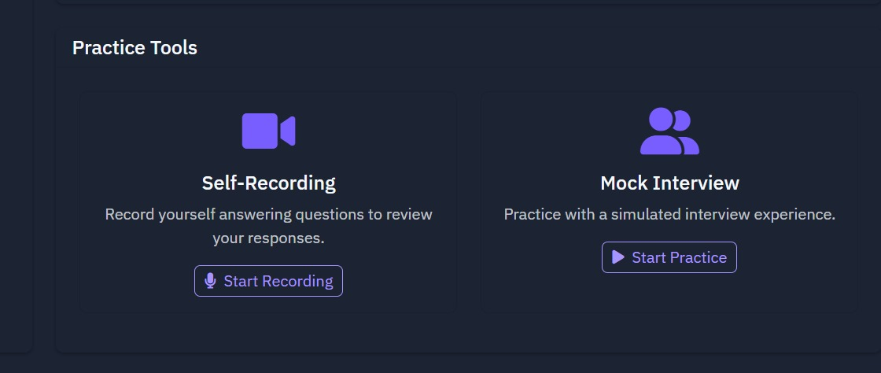
Resume And Interview Tips

Slide 14

Conclusion: Empower Your Career Path Today
Revolutionizing Career Planning
With actionable AI insights.
Join Our Community
Optimize Your Future
Sign up now!

Slide 15
Thank you

